Slide 1

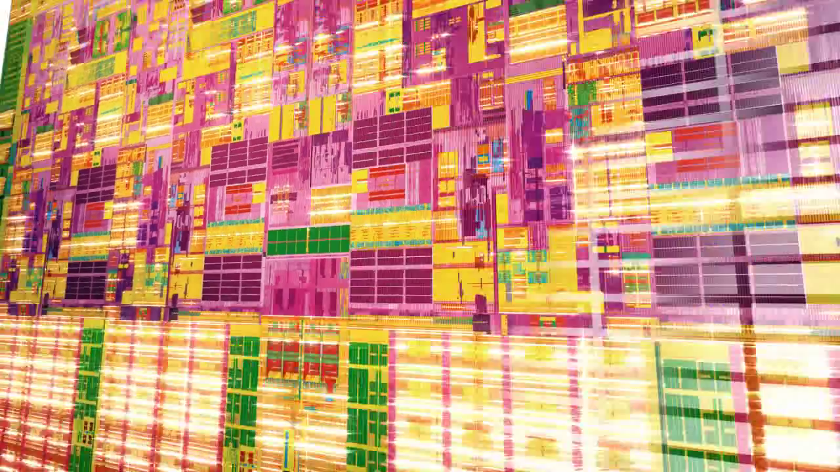

A Power Efficient Scheme for Speech Controlled IoT Applications
By,
Nisarg M. Vasavada

Slide 2
Outline
Overview
Literature Review
Speech Recognition
IoT: Embedded Wireless Internet Approach
Module Design
MVA-SI
Conclusive Observations

Slide 3


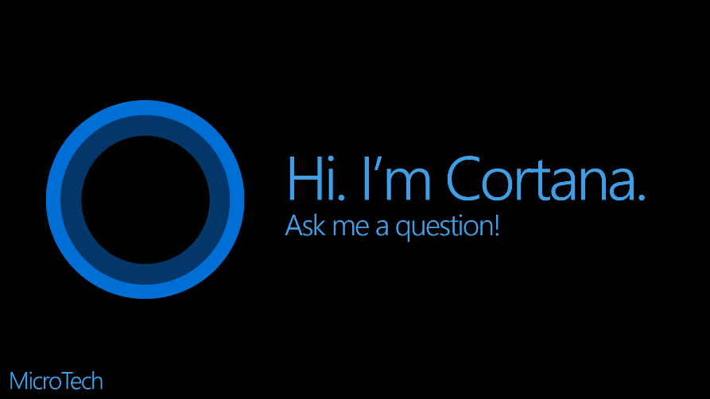
Speech Recognition
Signal Processing
Decoder
Acoustic Model
Language Model
HMM
Adaption

Slide 4
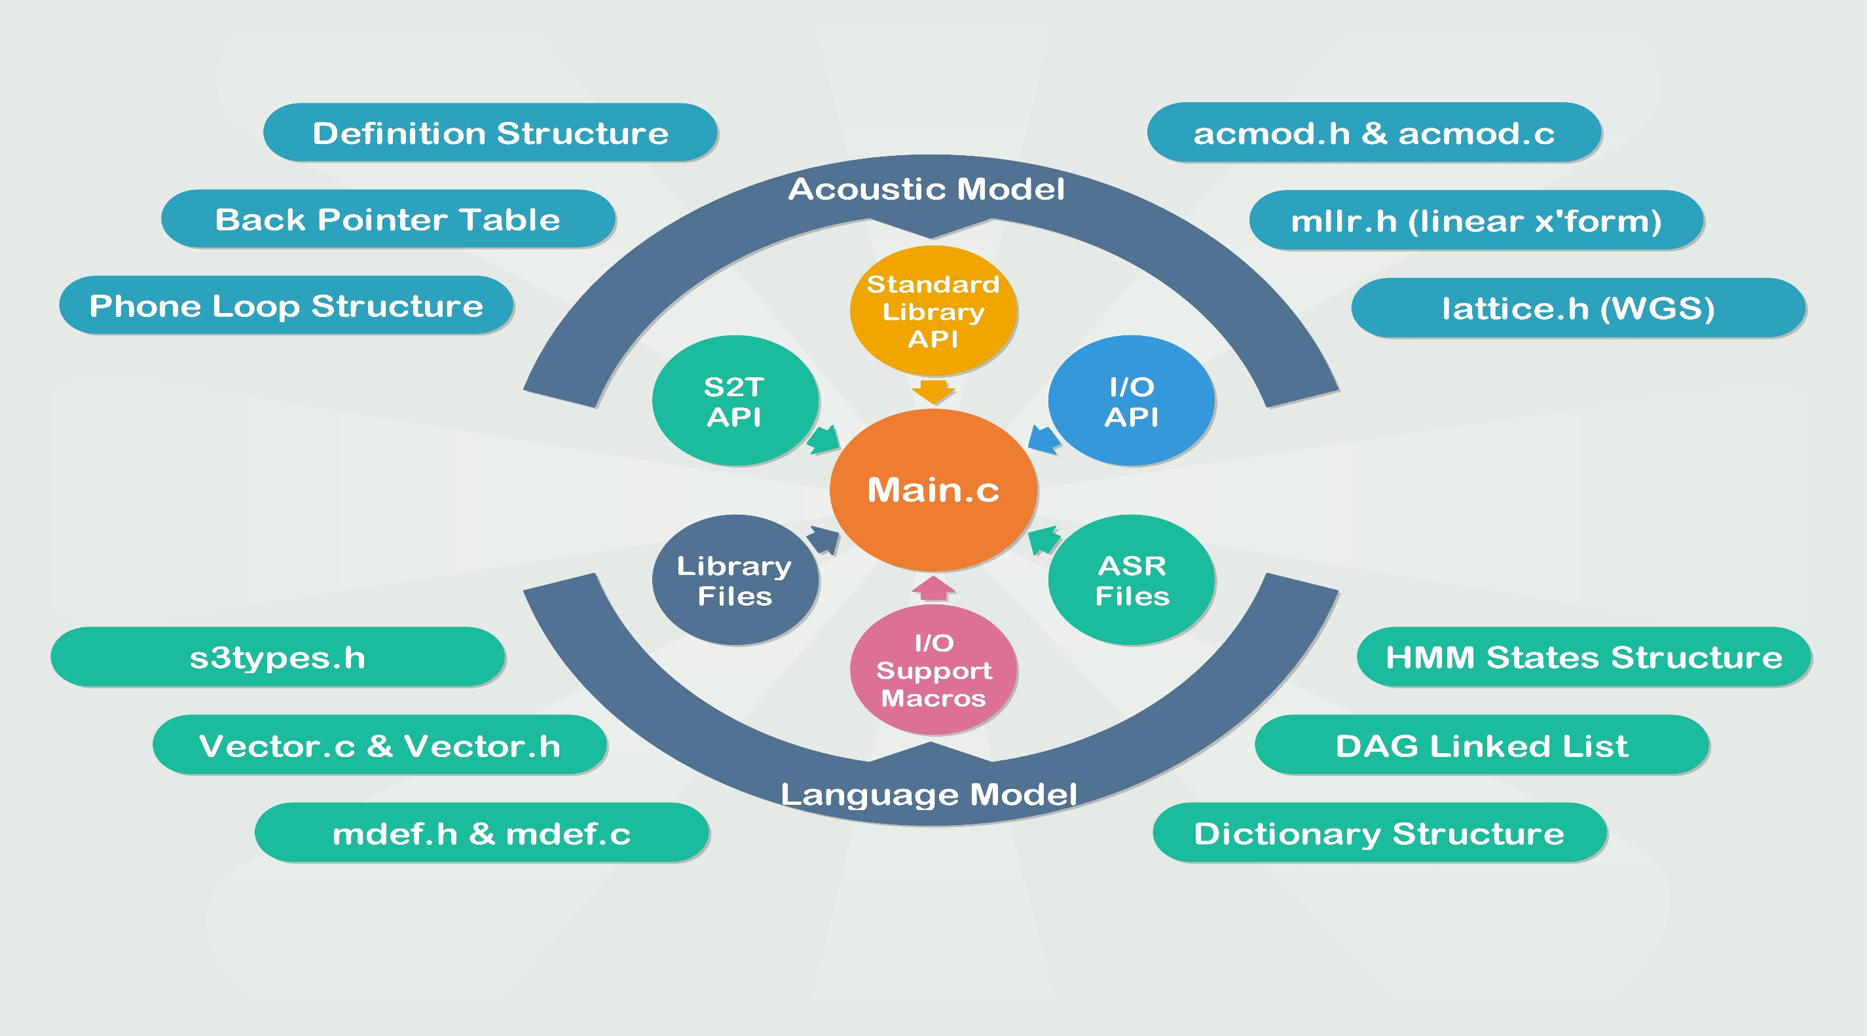

Slide 5
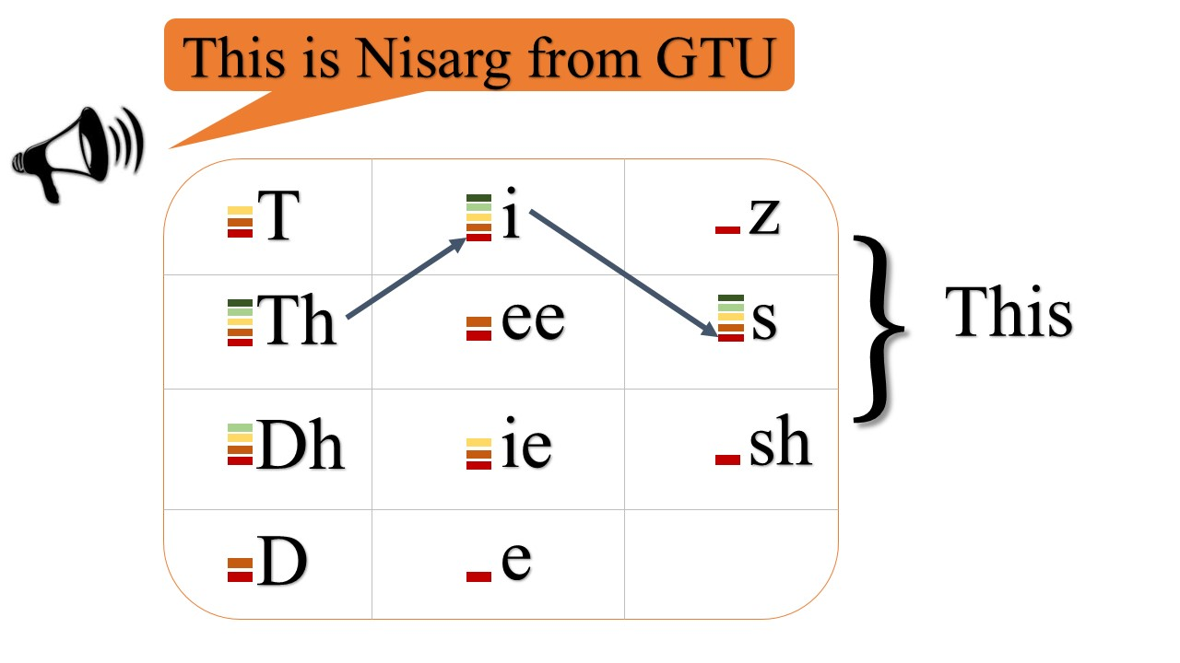
Acoustic Model Operation

Slide 6
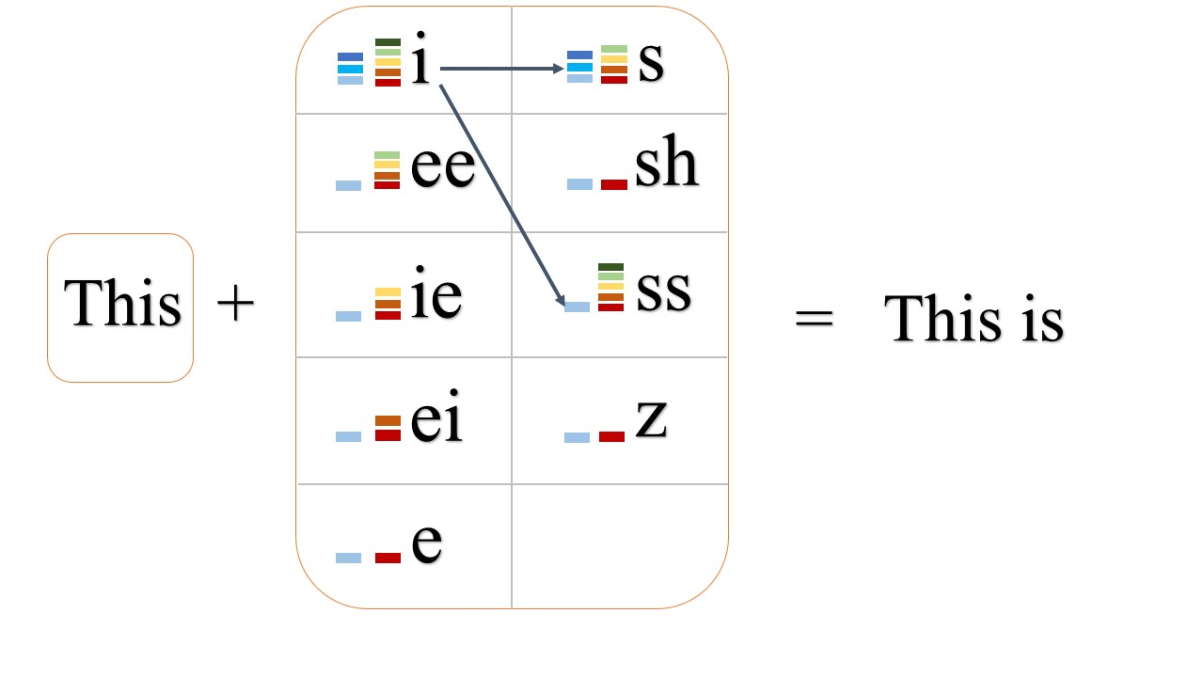
Language Model Operation

Slide 7
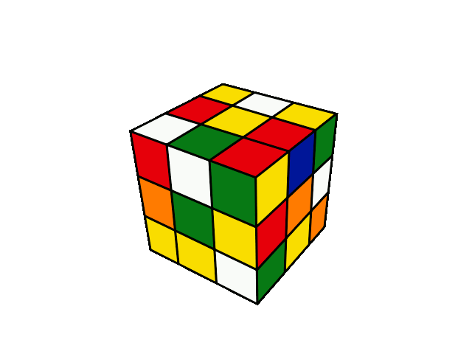
Does it Ring Any Bell?

Slide 8
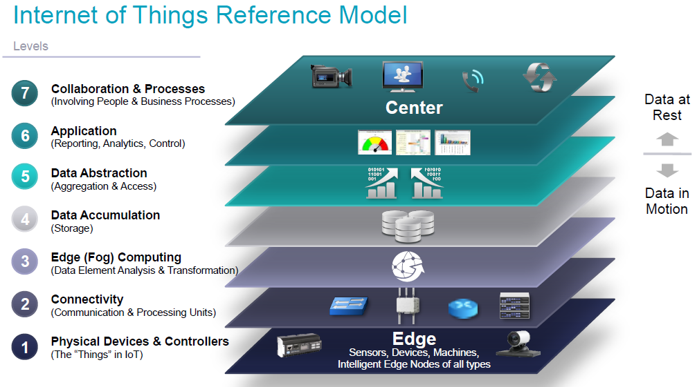
IoT – Conventional Approach

Slide 9
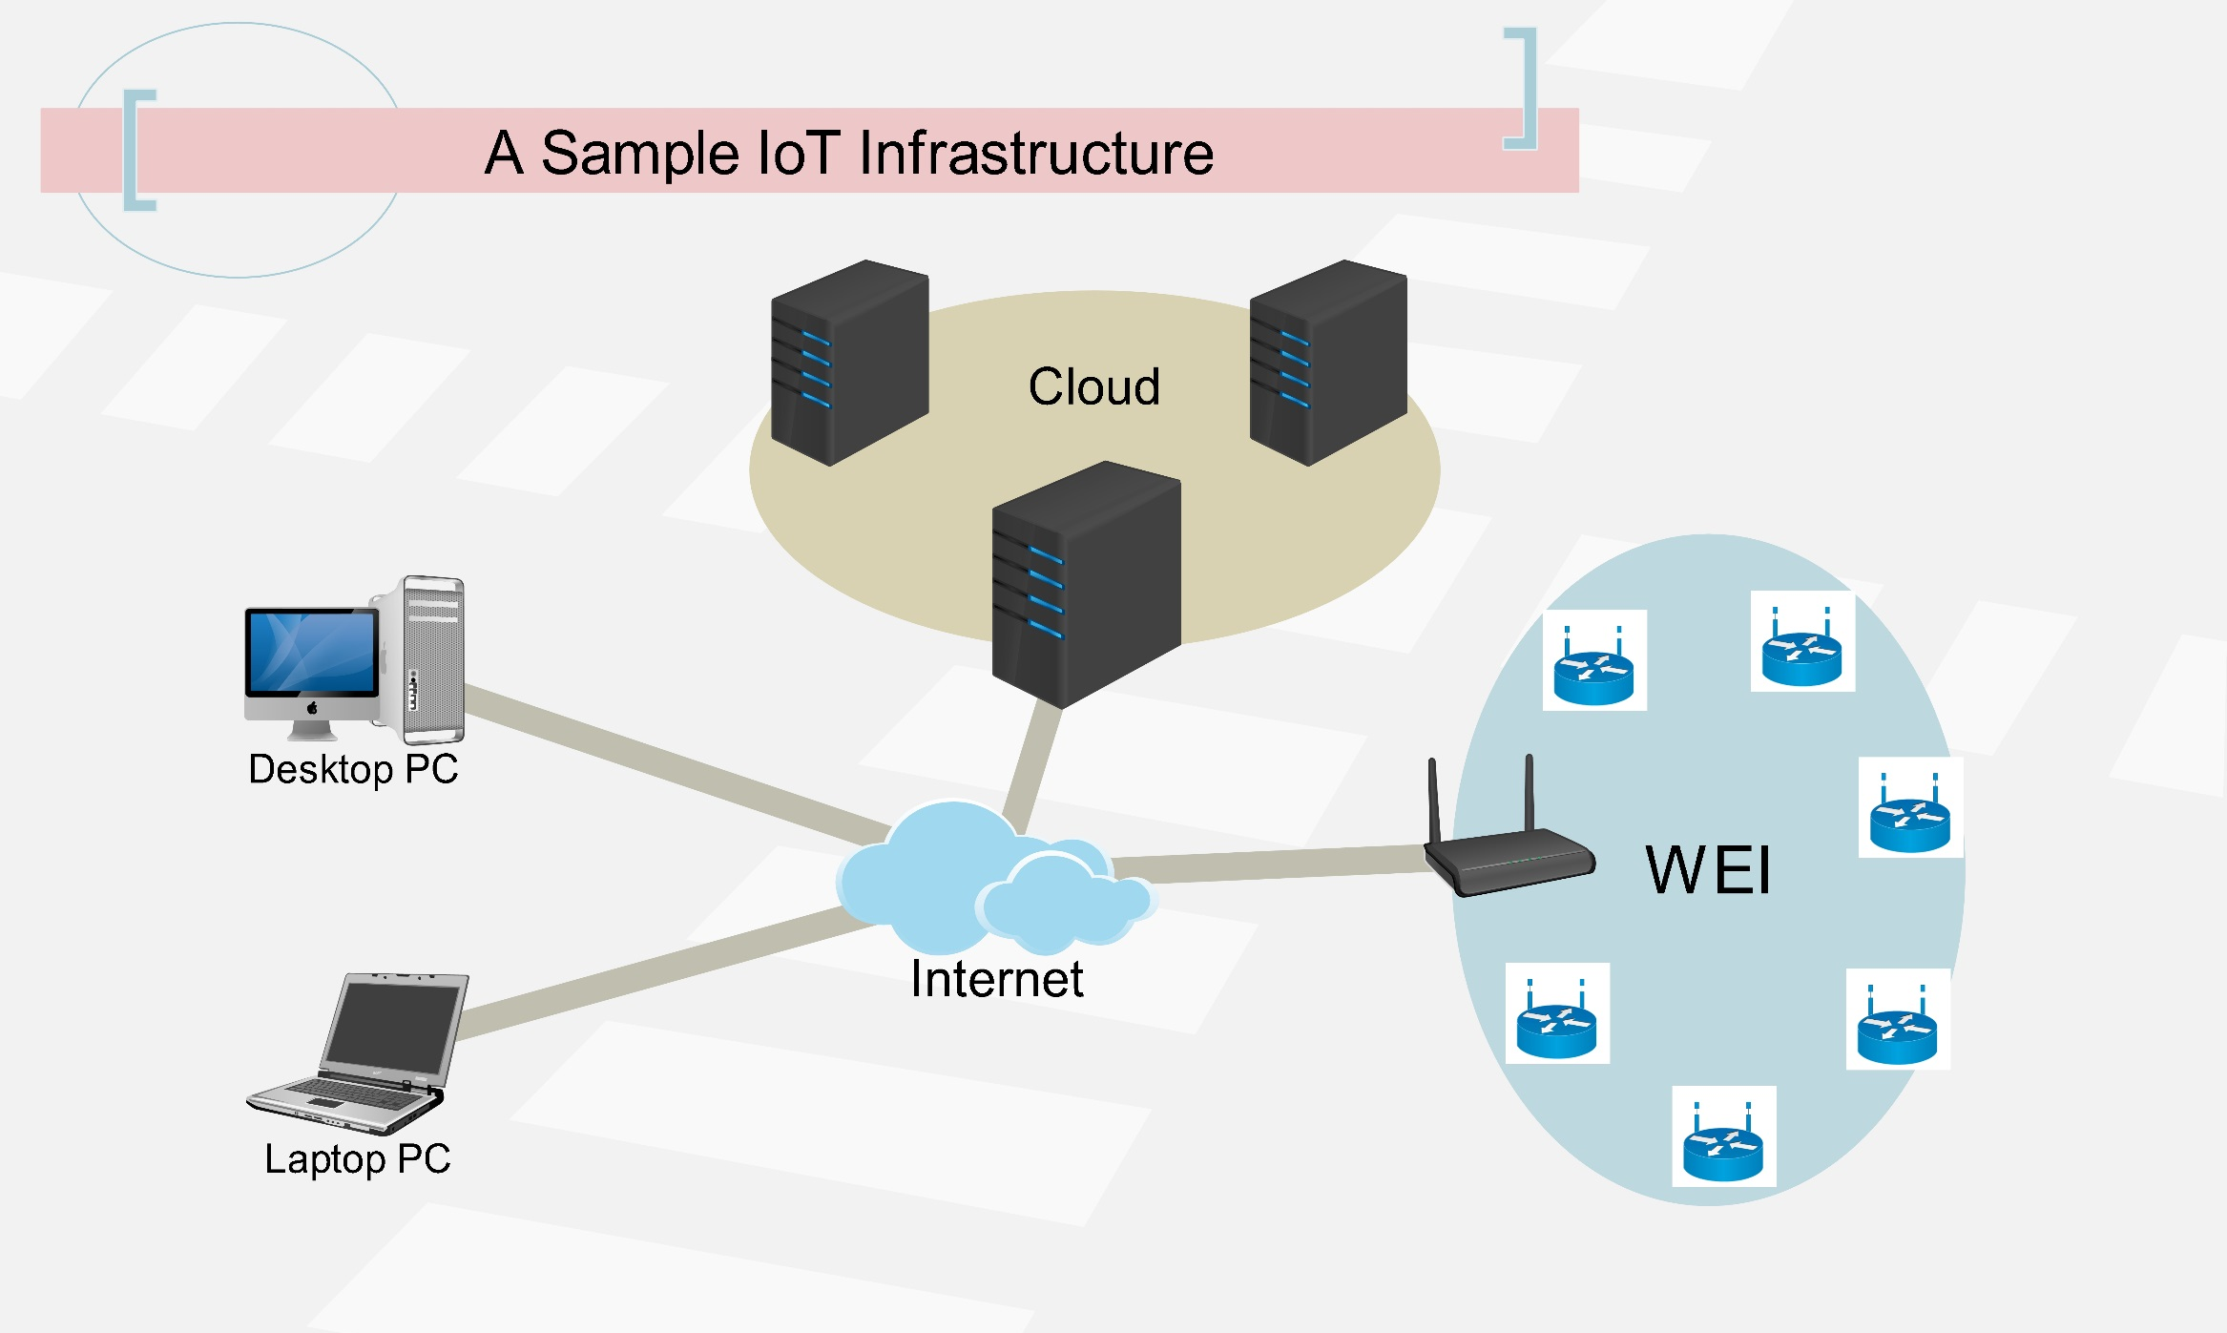
IoT – Wireless Embedded Internet Approach

Slide 10
The IoT – Wireless Embedded Internet Approach
LoWPAN Mesh FIB
{dest, next hop}
Application
Application
UDP
UDP
IPv6
IPv6
IPv6
LoWPAN
LoWPAN
LoWPAN
DLL
DLL
DLL
PHY
PHY
PHY

Slide 11
IEEE 802.15.4 Frame (127B)
21 B
1 B
40 B
8 B
53 B
4 B
MAC
L
IPv6
UDP
Payload
FCS
UDP IPv6 64-bit addressing
IEEE 802.15.4 Frame (127B)
9 B
2 B
4 B
108 B
4 B
MAC
L
UDP
Payload
FCS
UDP 6LoWPAN 16-bit addressing

Slide 12

The Literature Review

Slide 13
The Literature
No. | Reference | Year | Content | U | I
1 | Speech Recognition with HMM: A Review | 2012 | Introduction to HMM | ✓
2 | PocketSphinx: A free real time continuous SR for hand-held devices | 1990 | Understanding of ASR Implementation (An Example) |  | ✓
3 | Speech and Language Processing | 2009 | A complete guide for modern ASR | ✓ | ✓
4 | An Improved i-vector Extraction algorithm for speaker detection | 2015 | Base Research |  | ✓
5 | 6LoWPAN: Wireless Embedded Internet | 2000 | A complete guide for Embedded level IoT implementation | ✓

Slide 14

The Proposed Scheme

Slide 15
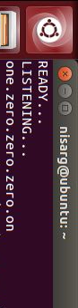
Cloud
Mic
Some other
node
Arduino
802.15.4
V
RPi
802.15.4
ASR
Display
I/O
Some other
node
MVA-SI
V

Slide 16
MVA-SI implementation
“Hello” call
Acoustic
Phone Recognition
Noise Removal
Vector Compare
Adaption Unit
Model

Slide 17
Mathematical point of view
P1 = [P(1)|P(2)]*[P(12)|P(3)] *[P(12…n-1)|P(n)]
P2 = [P(1)|P(2)]*[P(12)|P(3)] *[P(12…n-1)|P(n)]
If P1 = P2
P1’ = P1 *A ; P2’ = P2 *B
If P1’ > P2’
Pfinal = P1’

Slide 18
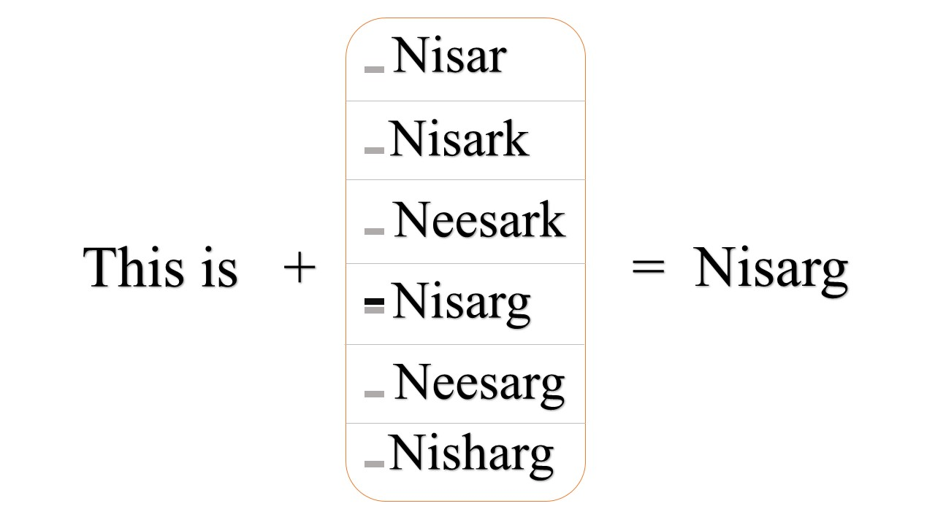
MVA-SI Impact

Slide 19
Conclusion
“Thus it can be concluded that the successful implementation of this scheme brings more accuracy, power efficiency and more coherent UI to the constrained IoT monitoring applications.”

Slide 20

Thanking Slide!

Slide 21
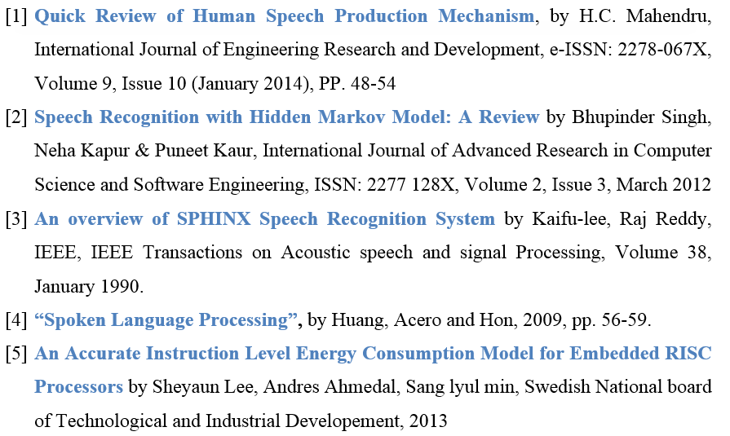
References

Slide 22
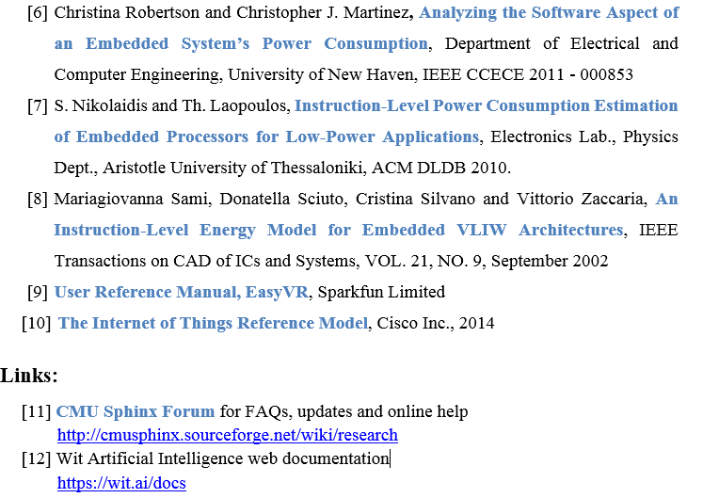
References

